Slide 1
Notes:
Pen

Slide 2
Community Organizing
Resident Council
Training Module 2
Mike Espinoza, TCM
Hope Flint, West Fresno Family Resource Center
Notes:
Mike

Slide 3

Vision and Mission Voting
Thank you to our Anchor CBO teams for the input on our vision and mission!
Take a look at what we all have created and vote on the choice that is in line with your values.
Remember: you only get to vote once.
Notes:
Pen

Slide 4
Agenda
Vision and Mission Voting
Meet the Presenters
Group Norms
Review Outcomes
Key Components of Community Organizing
Relationship Building Practice
Extended Learning and Next Steps
Community Resources
Notes:
Mike

Slide 5


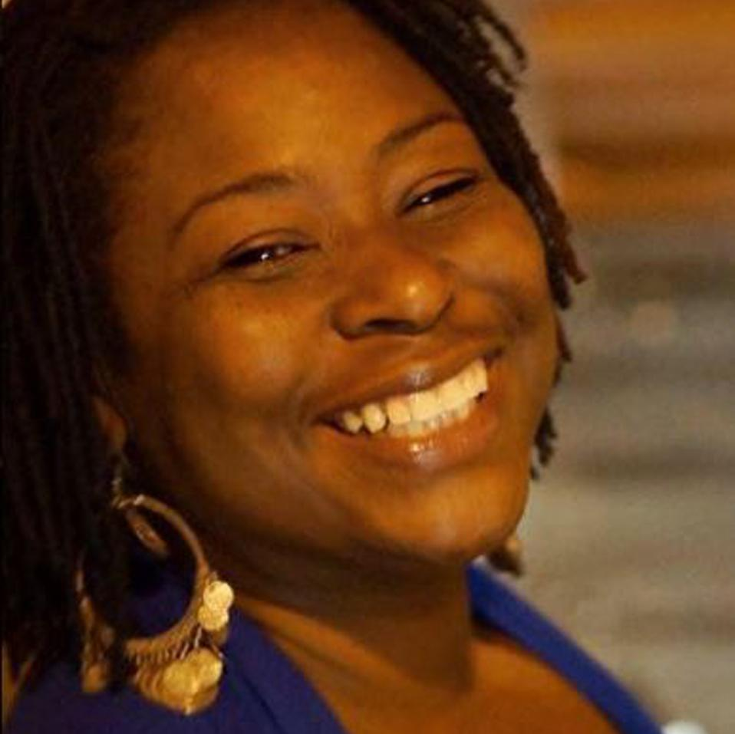
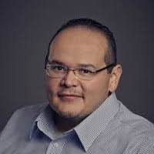
Meet our Presenters
Hope Flint
She is the Executive Assistant for the West Fresno Family Resource Center. She has a passion for serving the families in our community by educating and empowering them in her work.
Mike Espinoza
He is the Director of The Children’s Network and has over 20 years experience as a Community Organizer for various organizations for change.
Notes:
Hope and Mike

Slide 6
So, before we get started, let’s review our norms...
1. Be open to new ideas
2. Listen to each speaker
3. Make equal time for all to share
4. In person meeting: Please keep your phone on silent, and if you
need to answer the phone, please excuse yourself from the room.
5. During a virtual meeting we encourage you to have the camera on
to be fully engaged
6. Treat others the way you would like to be treated
Notes:
Hope

Slide 7
Vocabulary
Vision- describes the basic human emotion that founders intend to create an impact on the world
Mission- communicates the purpose and action of the vision creating a sense of identity for the organization
Values-one’s judgement of what is important in life
Community- a feeling of fellowship with others, as a result of common attitudes
Trust- firm belief in the reliability or truth
Notes:
Hope

Slide 8

Outcome for our training
Today we will learn how to develop ways of building a public relationship in a one on one meeting as the foundation for community organizing.
Notes:
Mike

Slide 9
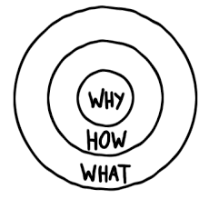
Why, How, What?
“Why” will always drive this work with the vision in mind created with our values.
“How” will include our mission statement and goals to achieve in this process.
“What” is the product we will create in the end together.
These are the Big Ideas!
Notes:
Mike explains the Golden Circle 5 min

Slide 10
Community Organizing begins with building a public relationship that needs the following elements:
Trust
Engagement, resources and incentives
Public vs. private
Relational capacity
Notes:
Mike

Slide 11
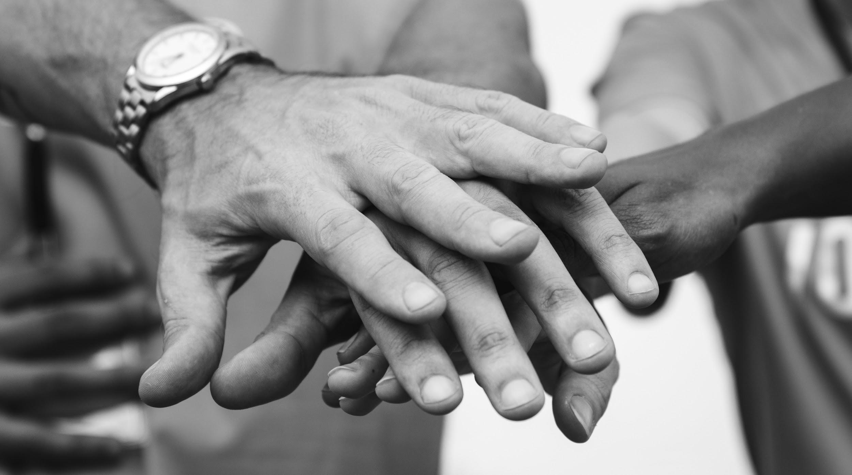


Trust...
How do you develop trust?
Notes:
Hope will share

Slide 12
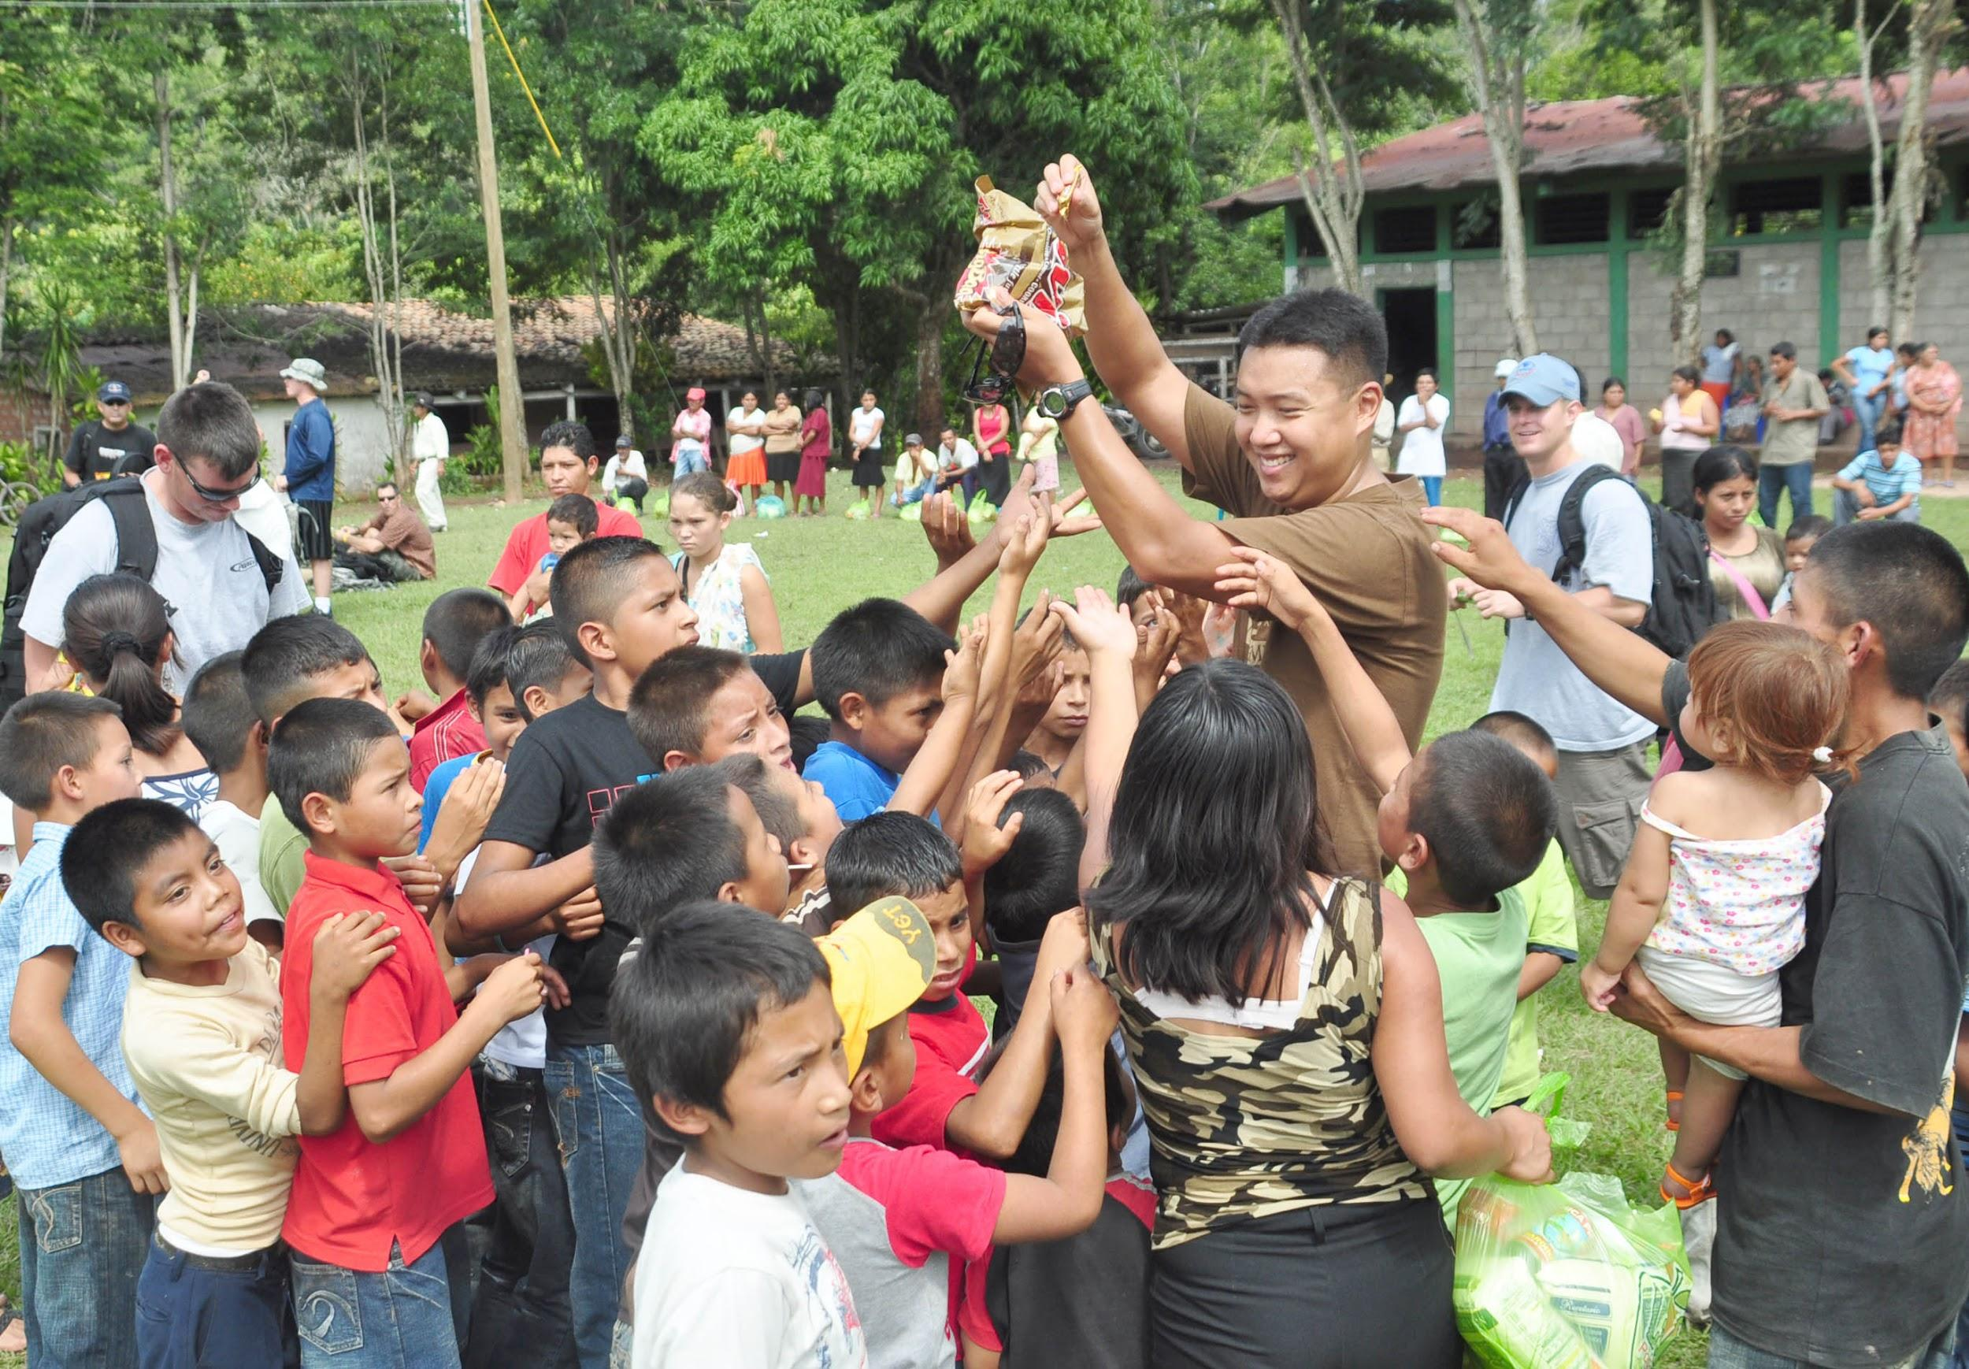
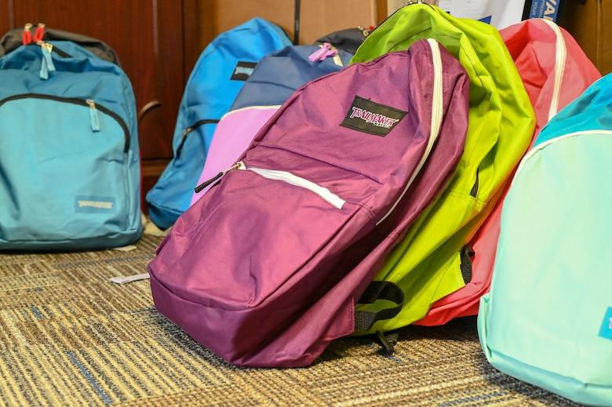
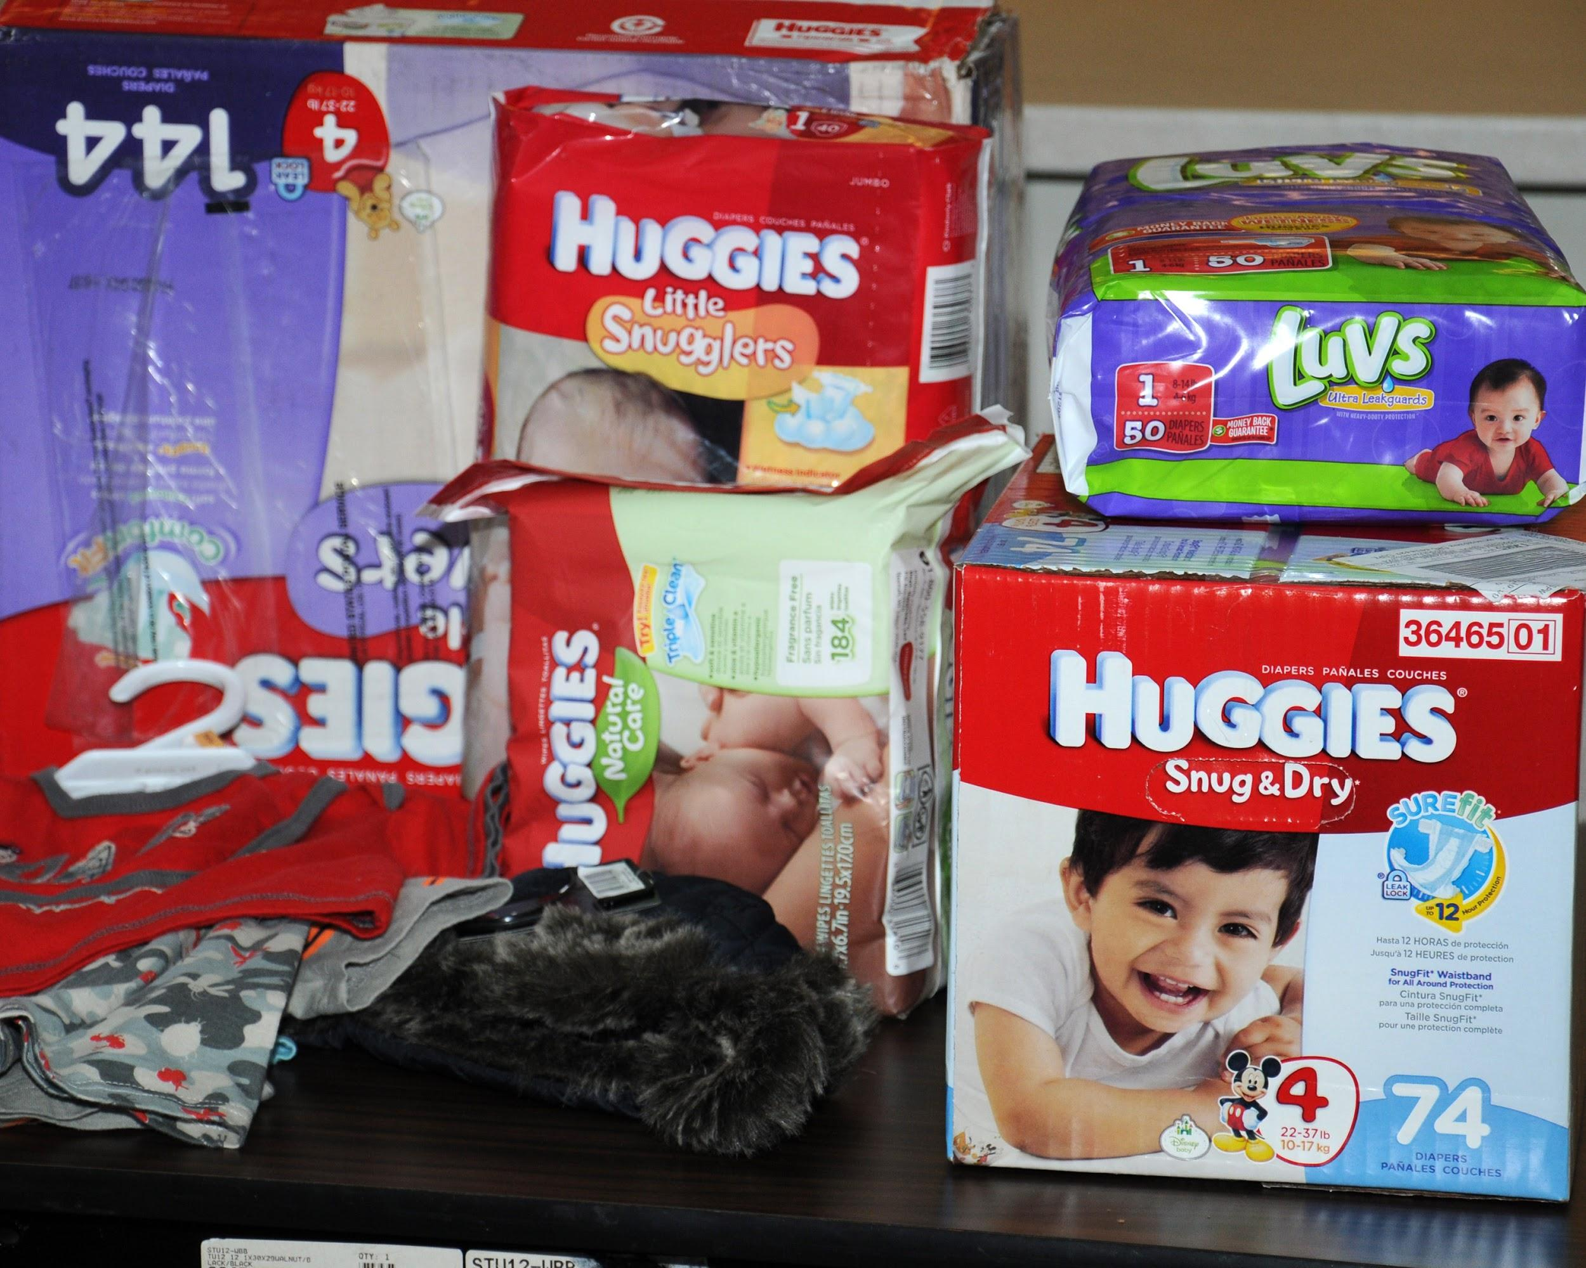
Engagement, Resources and Incentives
How can these be beneficial to community organizing?
Notes:
Hope

Slide 13

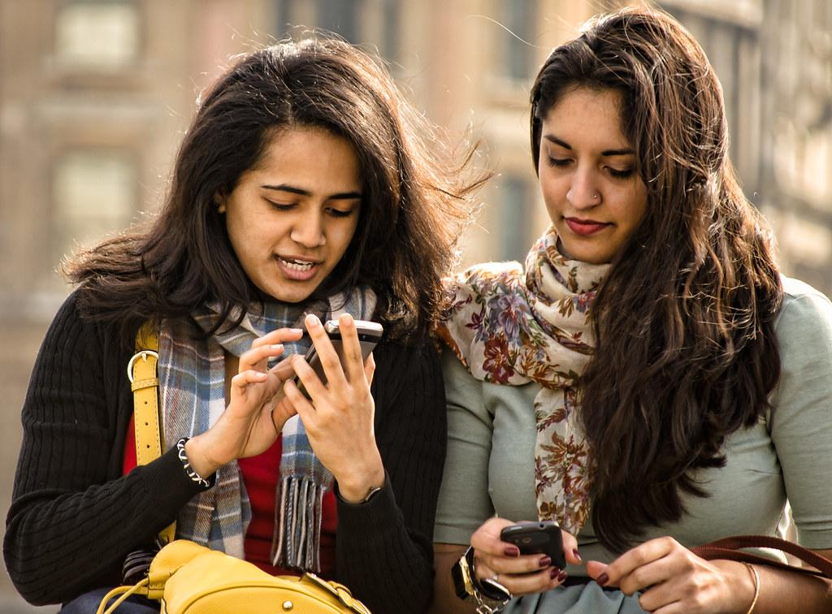
Public vs. Private Relationships
What is the difference and how do you develop one?
Notes:
Mike

Slide 14
Relational Capacity:
The ability to work together achieving cohesiveness with our mission and vision in mind as we build a team.
We will learn to depend on each other to achieve our goals with trusting relationships uniting us.
Notes:
Mike

Slide 15
Community Organizing Fundamentals
One on one meeting with directed agenda
Build trust
Meet people where they are
Create a community within a community
Take the experiences that are represented and move on to policy.
Notes:
Mike and Hope

Slide 16
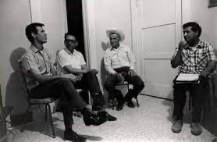
Meet Marcos.
He recently opened a camera shop near the Louvre in Paris.
Visitors to his store, mostly tourists, speak many different languages making anything beyond a simple transaction a challenge.
Tip
If one example isn’t sufficient to help people understand the breadth of your idea, pick a couple of examples.
Story for illustration purposes only
Notes:
Mike

Slide 17
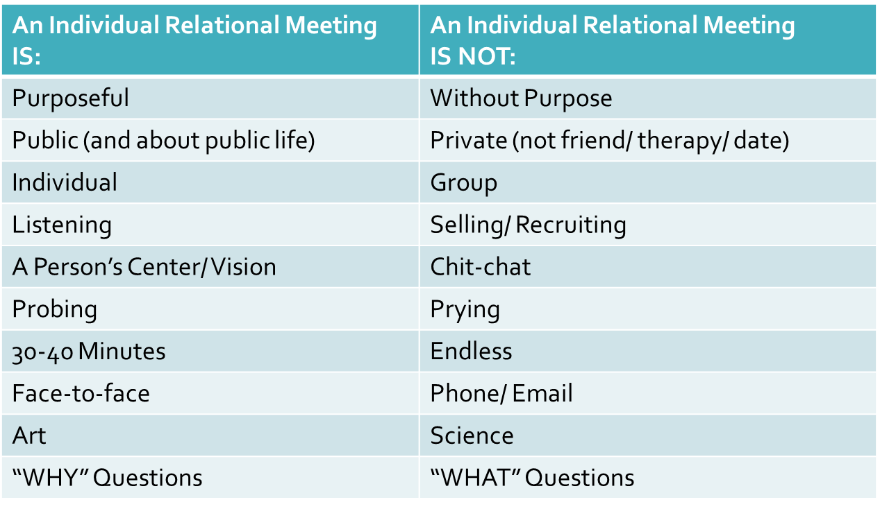
Public vs. Private relationships
What is the difference and how do you develop one?
Notes:
Mike

Slide 18
We will model the process for the one on one meeting using the Stick Figure Worksheet.
Next, you will fill it out on your own notes about yourself.
Then, you will meet with another Resident Council member to gather information about them.
Notes:
Mike

Slide 19
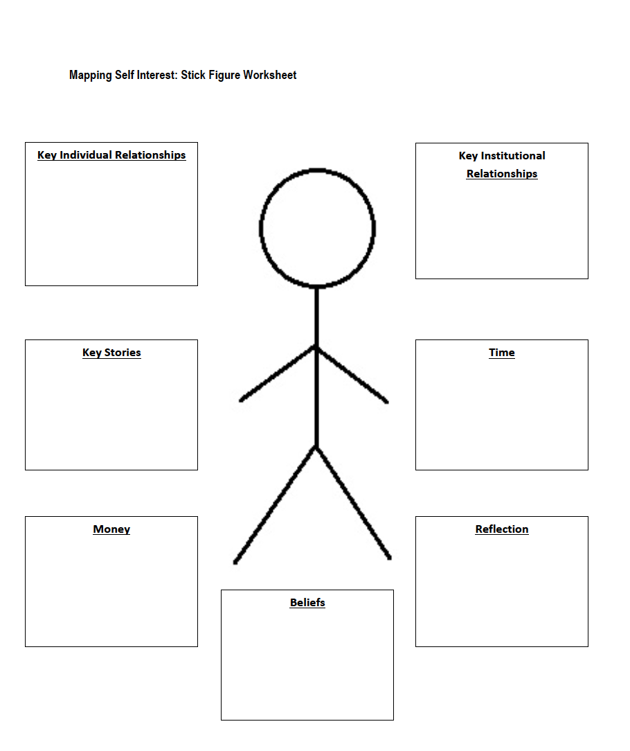
Notes:
Mike

Slide 20
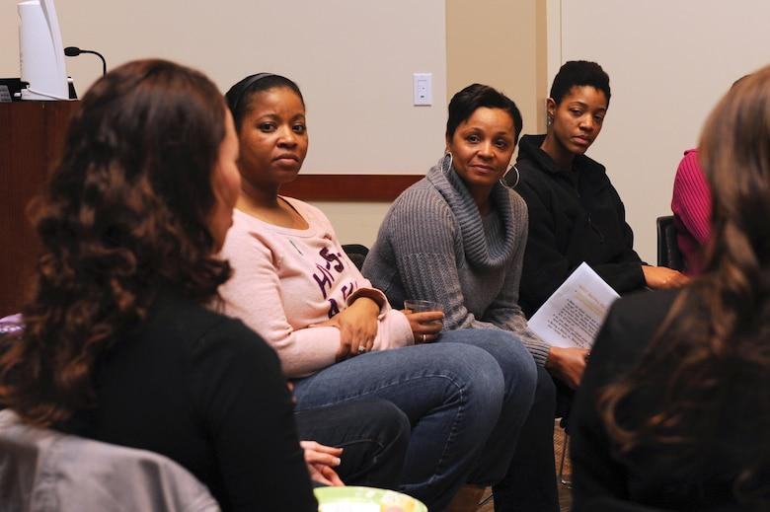
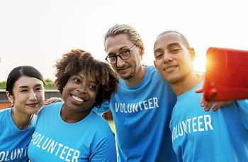
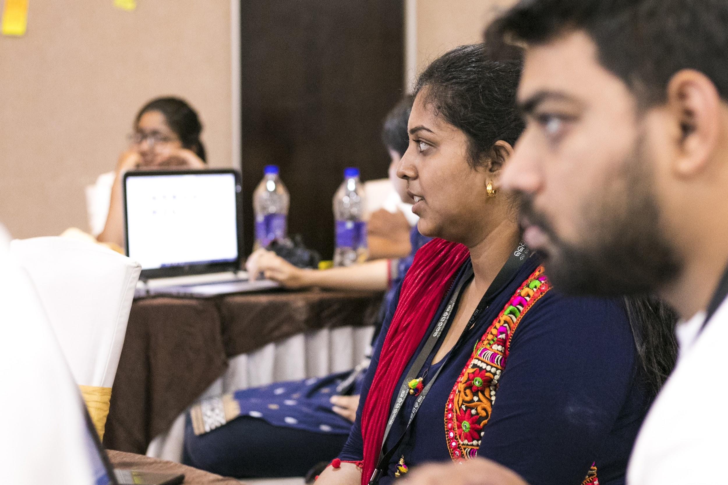
Create a Community within a community
This can be done when you meet the needs of all stakeholders.
Notes:
Hope

Slide 21
Homework:
Meet with another member of your CBO Anchor Team and have a one on one meeting. You can do this virtually or in a safe manner. Fill out the stick figure worksheet. We will share our learning at the next training.
Notes:
Hope

Slide 22
Next Training
Understanding the Fresno Landscape
October 19th from 5:30-7:00
October 23rd, Saturday from 10::00-11:30 am
Notes:
Mike

